Slide 1
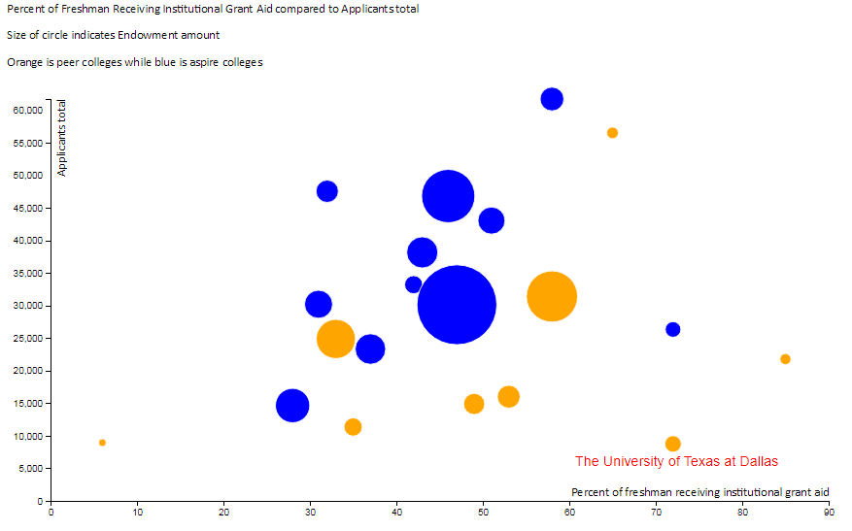
Slide 1: D3
Target Variable: Applicants total
UT Dallas endowment compared to aspire colleges and its peers is small but gives a large percentage of institutional aid to its freshmen. Clearly, the amount of aid given is not attracting more applicants. Reducing the scholarships awarded and diverting the funds towards the school would attract more applicants and investors in the future.

Slide 2
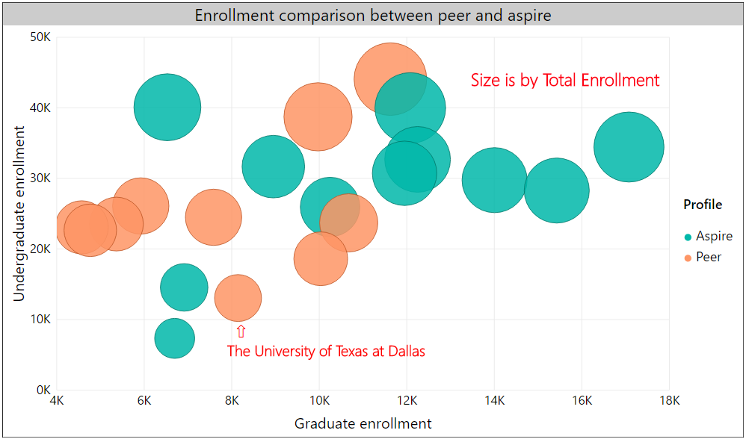
Slide 2: PowerBI
Target/Size Variable: Total enrollment
While UT Dallas' graduate enrollment is on par with the aspire colleges, its undergraduate enrollment is much lower even amongst its peers. Focusing on increasing undergraduate enrollment will positively affect the total enrollment and raise it into the same level as the aspire colleges.

Slide 3
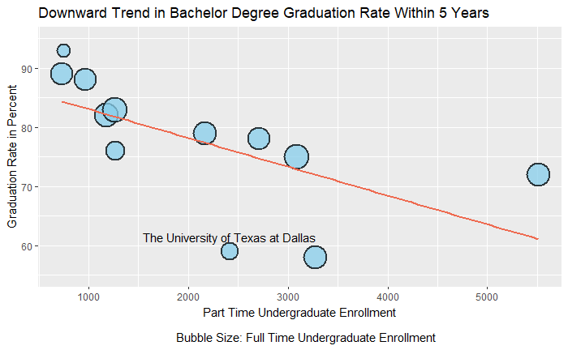
Slide 3: ggplot2
Target Variable: Graduation rate - Bachelor degree within 5 years, total
Limiting part time enrollment and thus redirecting people towards full time enrollment will positively affect the graduation rate by increasing the number of people graduating within 5 years

Slide 4
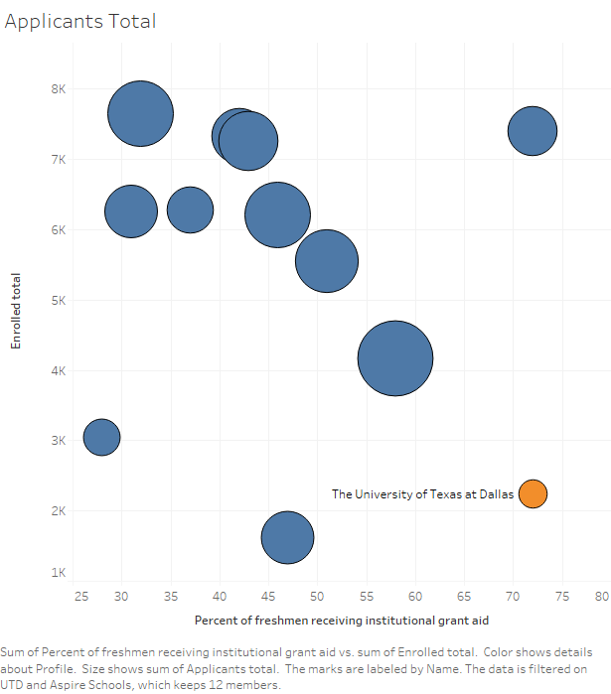
Slide 4: Tableau
Target/Size Variable: Applicants total
UT Dallas gives a higher percentage of freshman institutional aid compared to aspire colleges. Even so, the number of enrollments is much lower.

Slide 5
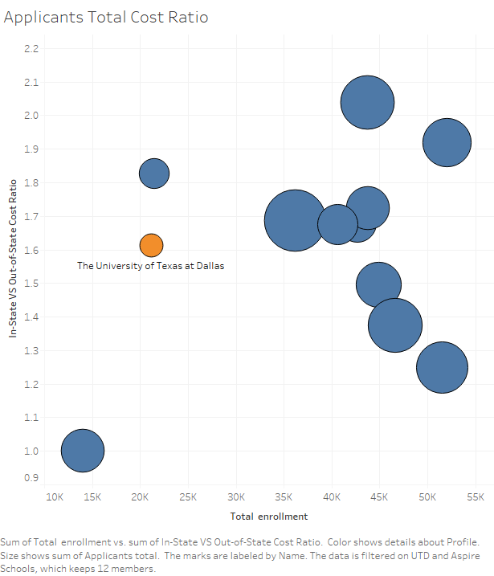
Slide 5: Tableau
Target/Size Variable: Applicants total
Cost ratio of out-of-state students to in-state students living expenses for UT Dallas is at a higher end, thereby affecting number of out of state applicants. Reducing the total cost for out-of-state students will decrease this ratio and attract more out-of-state applicants.

Slide 6
Slide 6: Recommendations
Following steps should be taken by UT Dallas to reach aspirational status:
- Reduce the number of scholarships awarded to students and also decrease the housing and total cost for out of state students
- Reduce scholarships awarded for part time students and increase number of full time enrollment
- Eliminate in-state tuition rates for students receiving scholarships
(see notes for citation on information)
- Focus on increasing undergrad enrollment as compared to graduate enrollment
- Focus on better utilizing endowments and reduced scholarships savings towards advancing the school
Notes:
UT Dallas gives scholarships that allow students in state tuition rates. (http://jindal.utdallas.edu/student-resources/scholarships/)

